Slide 1
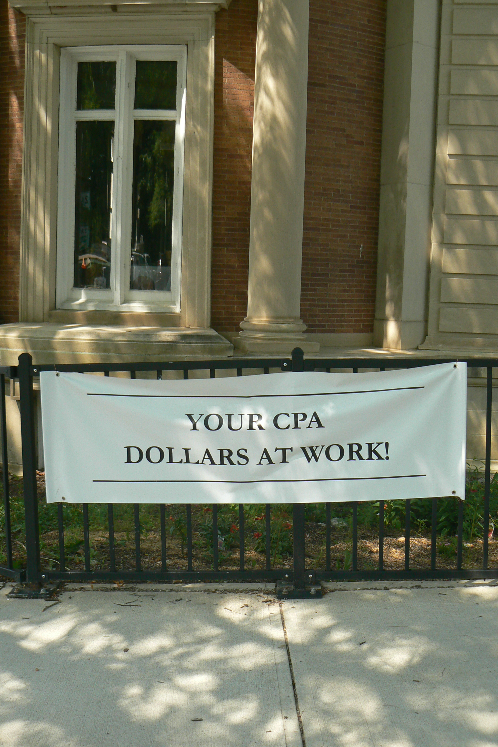
COMMUNITY PRESERVATION ACT
How to fund great initiatives in Shelburne

Slide 2
What is the CPA?
The CPA is a Massachusetts statute enacted in 2000. In a nutshell, CPA helps communities fund the protection of open space, historic preservation, affordable housing, and outdoor recreation.
CPA is a smart growth tool that was created to help communities:
Preserve open space
develop outdoor recreational facilities
Preserve historic sites
Create affordable housing
This funding is separate from the town budget, and is not able to be used for the typical things town budgets address: schools, DPW, municipal employees, maintenance of town facilities, etc. It can ONLY be used for projects in the four CPA categories: open space, recreation, affordable housing, historic preservation.

Slide 3
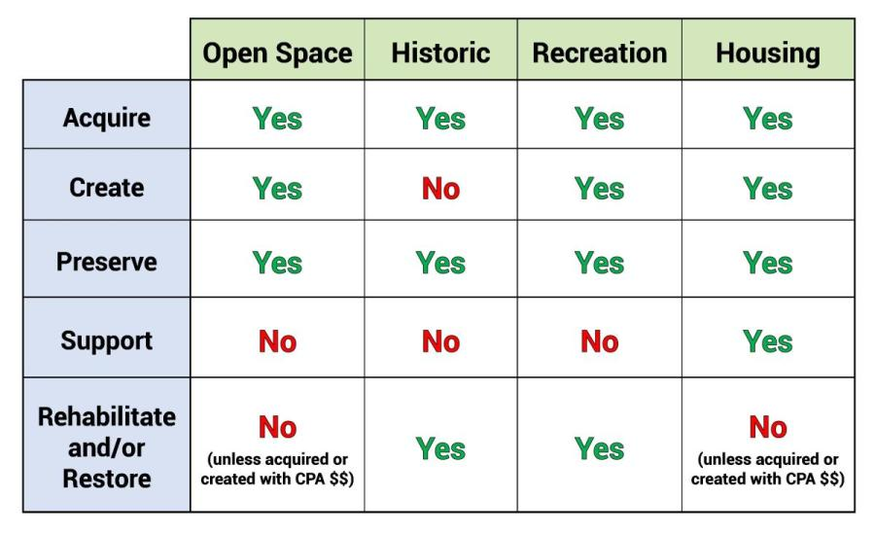
Projects are only eligible for CPA funding if they fit in a box with a green "Yes" in the chart below (chart adapted from "Recent Developments in Municipal Law", Massachusetts Department of Revenue, October 2012):

Slide 4
CPA in Shelburne
Shelburne residents voted to adopt the CPA at the 3% level by Town Meeting vote on June 11, 2022, and by ballot vote 59% yes/41% no on November 8, 2022. Accordingly, the Town Bylaws were amended by Town Meeting vote on May 2, 2023, to establish a Community Preservation Committee (CPC) to implement the CPA in Shelburne.
The Shelburne Community Preservation Committee formed in late 2023, spent time writing Shelburne’s Community Preservation Plan and application process in time to open up for our first round of funding in September of 2024. The Shelburne Community Preservation Plan is a working document that is reviewed each summer and adjusted in an attempt to make it more fitting to our community and to make it clearer and more understandable.

Slide 5
How does it work?
Cities and towns that adopt CPA obtain community preservation funding from two sources:
A local property tax surcharge
A Yearly distribution from the statewide CPA Trust Fund
(since 2013) State budget surplus (if any)
The CPA Trust Fund revenues come from a surcharge placed on all real estate transactions at the state Registries of Deeds. The surcharge for most transactions is $50, while municipal Lein certificates are subject to a $25 surcharge. Depending on how the real estate market is doing, these fees can add up to around $60 Million each year. CPA Communities receive their distribution from a formula-based percentage of what they raised locally.

Slide 6
How does the funding formula work?
As more communities have adopted CPA, the percent distributions to each community have gone down. Funds are distributed in three rounds:
Round 1: every community gets the same percentage of what has been raised locally.
Round 2: Communities are weighted so that smaller populations with lower property valuations per capita are rated higher. Smaller communities with higher CPA surcharges in rural areas with lower property valuations can get up to a 100% match in round 2, as Shelburne has so far enjoyed.
Round 3: is optional, at the discretion of the Commissioner of Revenue, who has chosen to issue a third round every year since 2010.

Slide 7
By Law, local community preservation committees put their money into five accounts, divided by percentage:
10% must be used for historic preservation
10% must be used for affordable housing,
10% must be used for open space preservation or recreation
5% goes into an administrative account to pay for our clerk, photocopying, and supplies.
$65% is flexible, and can go to any of the categories depending on what our town chooses to use it for.
The Shelburne CPC held a public hearing in the summer of 2024 where we asked the attendees to vote by bean for their priorities among the four categories, and the response was equally divided between the categories.

Slide 8
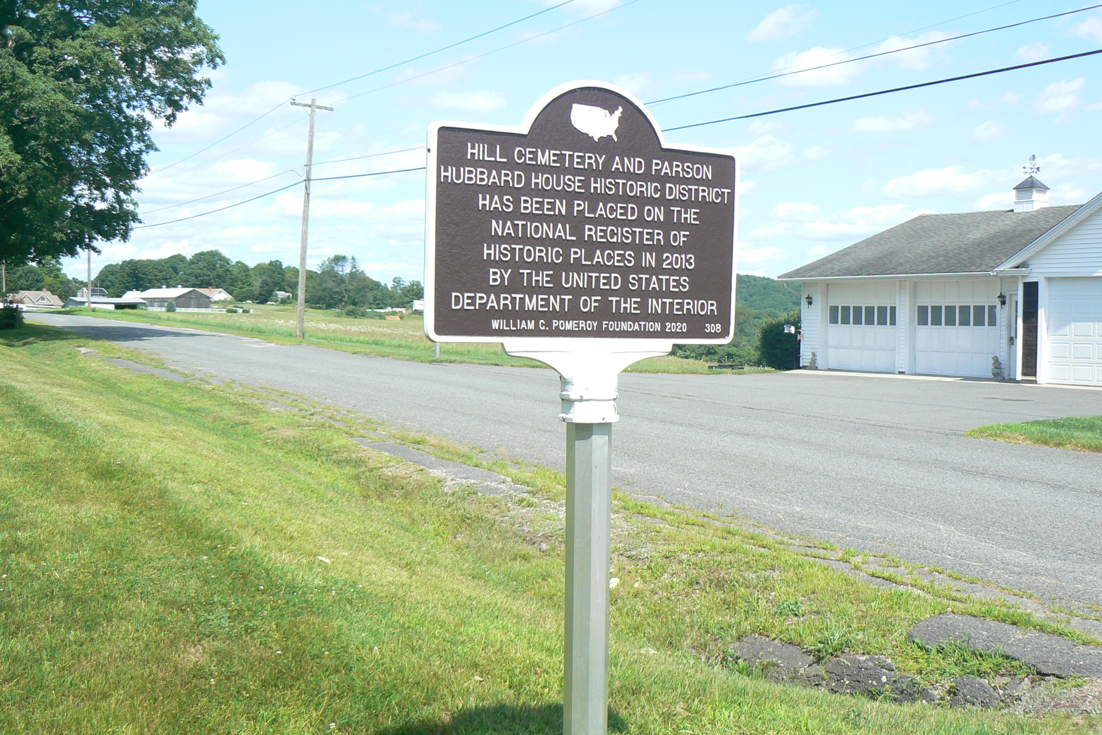
Shelburne’s Historic Preservation goals
Preservation and protection of Shelburne’s historic buildings, façades, and landscapes
Prioritizing of historic preservation projects that serve multiple public purposes
Preservation and repair of headstones and markers at Shelburne’s cemeteries
Providing accessibility at historic sites

Slide 9
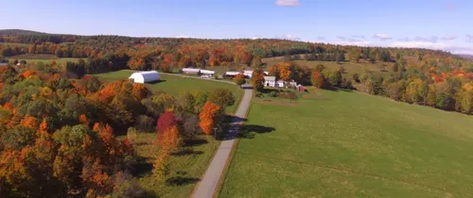
Shelburne’s Open Space Goals
Protect land that allows public access to open space, particularly lands along the Deerfield River.
Promote and support the viability of farms and forests.
Protect lands that have ecological, historical, agricultural, cultural, and recreational significance, including places that are significant to indigenous peoples.
Protect lands that are wildlife corridors, sequester carbon, and are contiguous with other undeveloped tracts of land.
Create public spaces in Shelburne Falls village where residents can meet, socialize, stay active, eat together, and/or enjoy arts and culture.

Slide 10
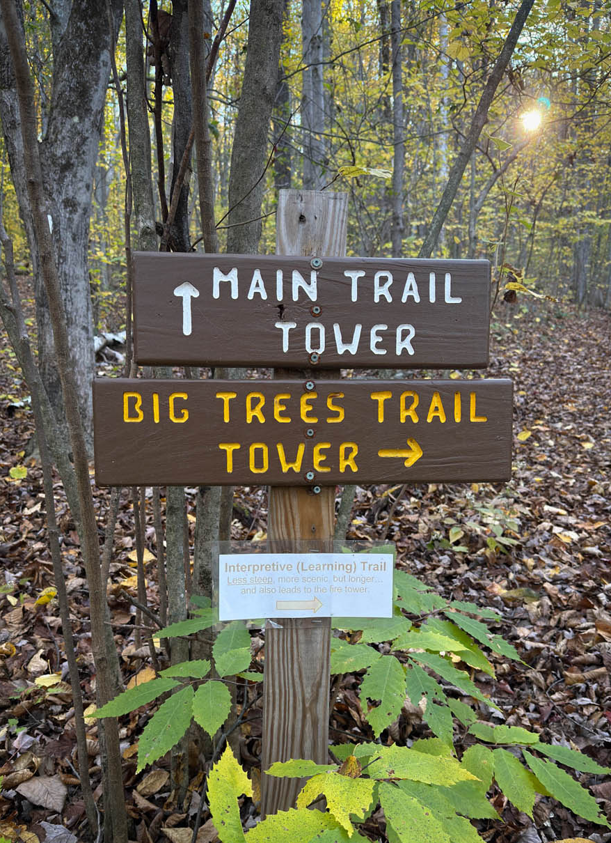
Shelburne’s Outdoor Recreation Goals:
To enhance and provide public access to the Deerfield River for fishing, swimming, and boating, particularly within the village.
To expand the number of multi-use trails in Shelburne.
To provide opportunities to link walking options in the Shelburne Falls village to locations outside the village.
To maintain and expand the outdoor recreation options for people of all ages and abilities in Shelburne.
To create public spaces in Shelburne Falls village where residents can meet, socialize, stay active, eat together, and/or enjoy arts and culture.
To create a natural public swimming area in Shelburne.

Slide 11
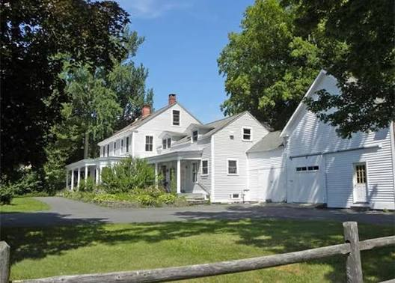
Shelburne’s Housing goals
Actively pursue and fund a variety of community housing initiatives to increase housing choice and enhance Shelburne’s diversity and vibrancy.
Promote affordable, safe, ADA-accessible and energy efficient rental opportunities.
Increase options for first-time and first-generation homebuyers.
Support affordable housing for all ages, abilities and income levels.
Support the creation of affordable units that count on the state’s Subsidized Housing Inventory, per MGL c.40B, by funding context-sensitive developments.
Encourage the inventive reuse of existing buildings or new buildings on previously developed sites.

Slide 12
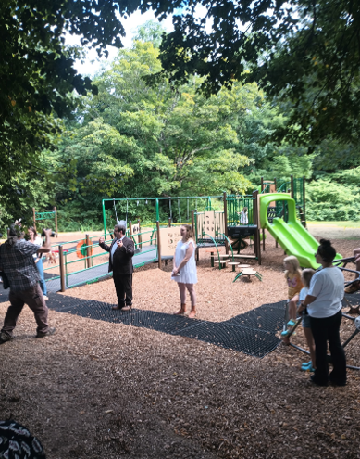
Funded Projects in Shelburne
The Rehabilitation of the Buckland-Shelburne Elementary School playground
Making the Arms Library accessible by the installation of an elevator
The construction of a bulletin Board at Cowell Gym
Repairs and maintenance at Hill Cemetery
An engineering assessment of the Stone Tower as a first step toward structural repairs
Agricultural preservation of 200+ acres at Wheelview Farm in the Patten District

Slide 13
How to get started…and Timeline
Download the Application instructions, pre-application, and Application on the town website.
Submit your pre-application by September 15
If the CPC gives you notice that you can move ahead with an application, submit your application by November 16
The CPC will have more questions for you, come to our meeting as requested to answer our questions.
You will know by April if the CPC is recommending your project to be funded at the Town Meeting
Projects go before the Town Meeting in early May
Money becomes available in July
Projects can get started, funding is administered by the Town
Display your CPA Dollars at Work banner!

